Slide 1
Domestic Electricity bill monitoring
Group- 47
D GIRISH- 2011188.
DEEPAK KUMAR- 2011190.
K AVINASH REDDY- 2011251.
KAMATHAM SRINADH- 2011197.
VELURU JAYAVANTH REDDY- 2011233.

Slide 2
Introduction
The present electricity bill generation is done manually.
Highly Person dependant.
Human errors cannot be avoided.
Billing done mainly on estimated/ monthly average basis
In rural areas billing is delayed.
Meter data used only for billing, cannot help in analysis like demand analysis, energy audit, pinpointing losses, etc.

Slide 3
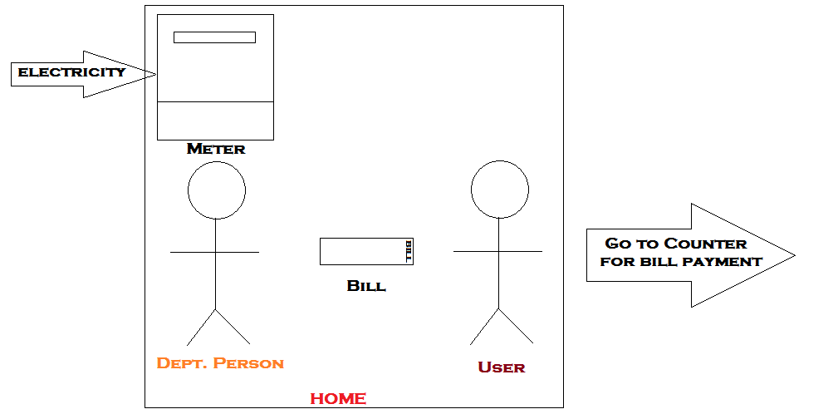
Present day system

Slide 4
Problems Specification
To Generate Electricity Bill, Person must go door to door which delays the process and requires more man power.

Slide 5
Sub problems
In Villages there are many delays in issuing bill, which makes it difficult for people to pay the bill in time.
Most of the people pay their bill in cash for which they have to wait in long queues.
Now-a-days we can see Theft of Electricity in large scale which causes great loss to the electricity department.
In villages disconnecting the connection is difficult as they threaten the person who come to disconnect connection

Slide 6
Mission Statement
Reducing Human Effort.
Reducing paper work -> saving trees -> maintain environmental balance

Slide 7
Need Statement
To Device a system that can send alerts about Daily Usage,Monthly Bills and Other info like powercuts etc to the user and update stats of Electricity Department.

Slide 8
Functions included
Auto disconnection feature.
Power cut information will be provided in advance so that farmers can cultivate the crop accordingly.
Daily updates of usage are provided so that people can reduce their bill accordingly.
Tampering detection
Automatic bill payment through bank account

Slide 9
Functions to be implemented in Design
It must have a Display which shows information about stats i.e. Daily Usage and other things.
It must have Some controls like Buttons in it for primary controlling.
It must Send Alerts for Users and Update stats in Dept.
Remote Monitoring must be provided to Dept.

Slide 10
Survey statistics
According to our survey, almost 80% of the users have digital meters.
85% of the users in rural areas have complaints about delays in bill issuing/generation
93% of the users said they can save electricity if they get daily usage updates
60% of the people have power cuts and have little or no information about it.
70% of the users in rural areas have no information about the changes in charges/unit.
70% of the users accepted that there are delays during repairs

Slide 11
Conclusions
According to the survey majority of the people have an electricity connection with digital meters.
As per our survey many villages are affected by power cuts without prior notice which makes it difficult for farmers.
Charges/units of electricity are increased very often but very few people keep track of this information.

Slide 12
Conclusions
In Villages there are many delays in issuing bill, which makes it difficult for people to pay the bill in time.
As per our survey most of the people agreed that they can save electricity if they get daily updates of power consumption.

Slide 13
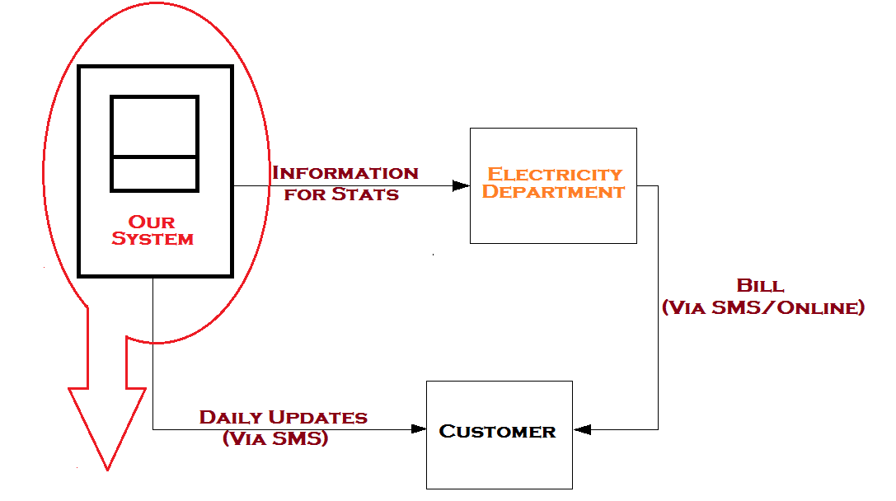
Process flow

Slide 14
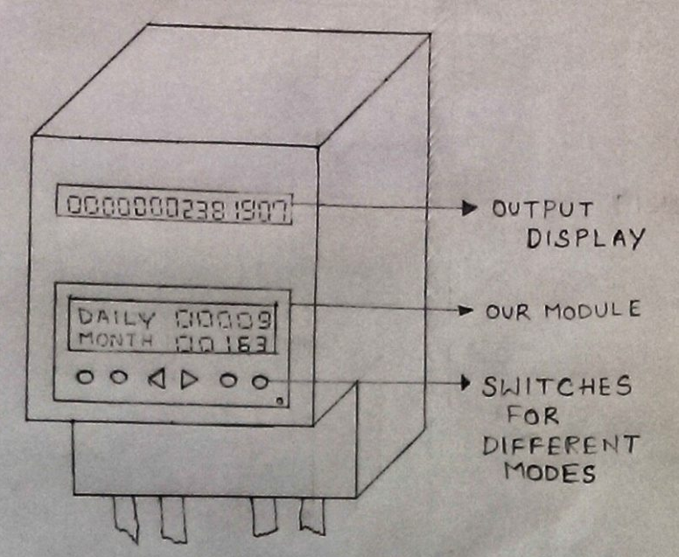
Design Concept - 1

Slide 15
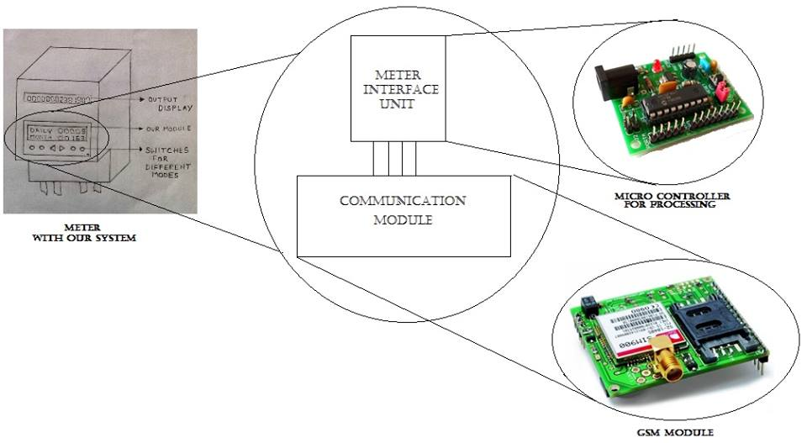
Design concept

Slide 16
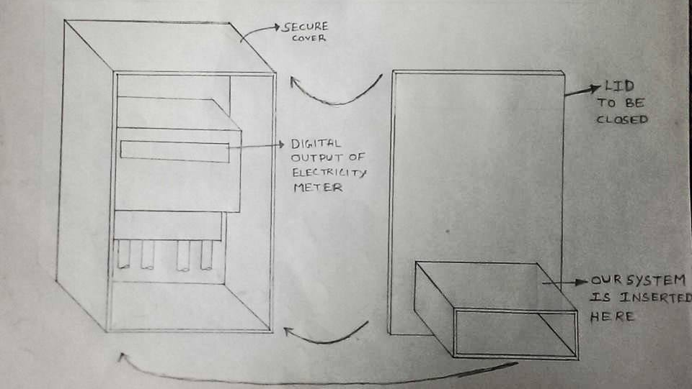
Design Concept- 2

Slide 17
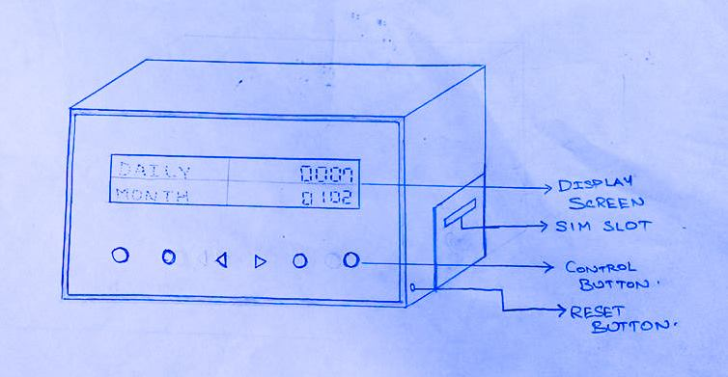
Design concept-3

Slide 18
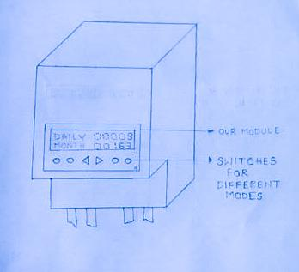
Design concept-4

Slide 19
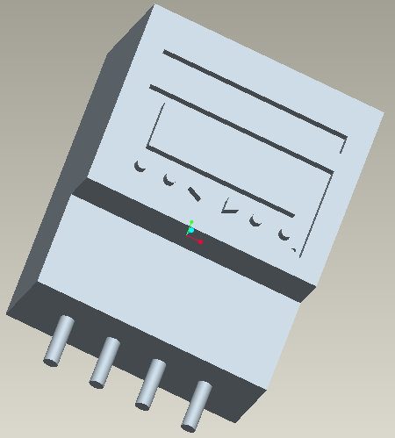
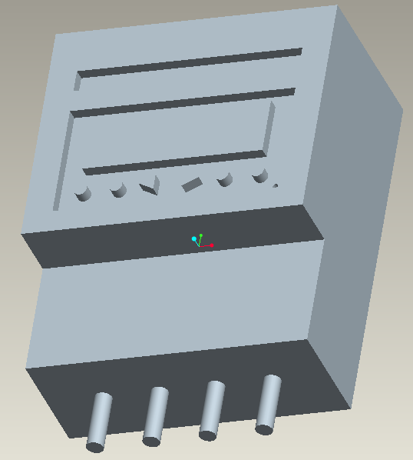
CAD Model-1

Slide 20
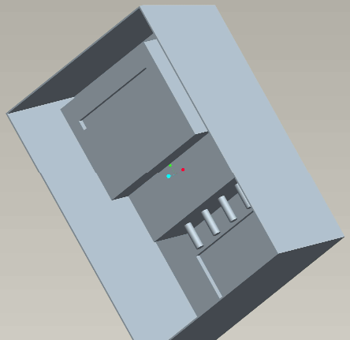
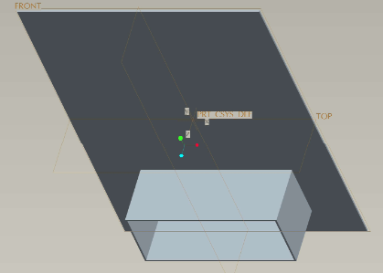
CAD Model-2

Slide 21
Communication module
Main purpose of communication module is to send the data to the electricity department database
There are many ways in which we can do this
Wireless
Communication through Mobile network
WLAN
Wired
Through LAN connection

Slide 22
Communication through mobile network
We use a GSM module to do this.
There will be a SIM Card inserted in the system to communicate with the department
System collects the information from the meter and sends the data to both customer and electricity department
Customer receives daily alerts directly from the system

Slide 23
Wireless LAN
The System is connected to the internet through Wi-Fi(WLAN)
There will be a database for the customers in the electricity department
Any alerts will be pushed from the database to the customers mobile through the system

Slide 24
LAN
It is same as WLAN except it is connected through wire(Ethernet cable).

Slide 25
Advantages
Advantages
No need of human effort for issuing bills
No delays in issuing bills
No need to wait in long queues to pay the bill
Tampering is prevented
Automatic error detection and correction system

Slide 26
Disadvantages
Disadvantage
Extra cost due to messages/internet connectivity.
Repairing the device is difficult i.e. if there are any issues the device has to be replaced.
Installation charges will be levied.

Slide 27
Ratings
Parameter | Concept -1 | Concept-2 | Concept-3 | Concept-4
Aesthetics | 8 | 6 | 7 | 6
User Friendly | 7 | 5 | 9 | 7
Security | 8 | 9 | 7 | 8
Ease of Design | 7 | 8 | 9 | 6
Repair ability | 7 | 8 | 8 | 7
Sum | 37 | 36 | 40 | 34

Slide 28
Thank you……..!

